Slide 1

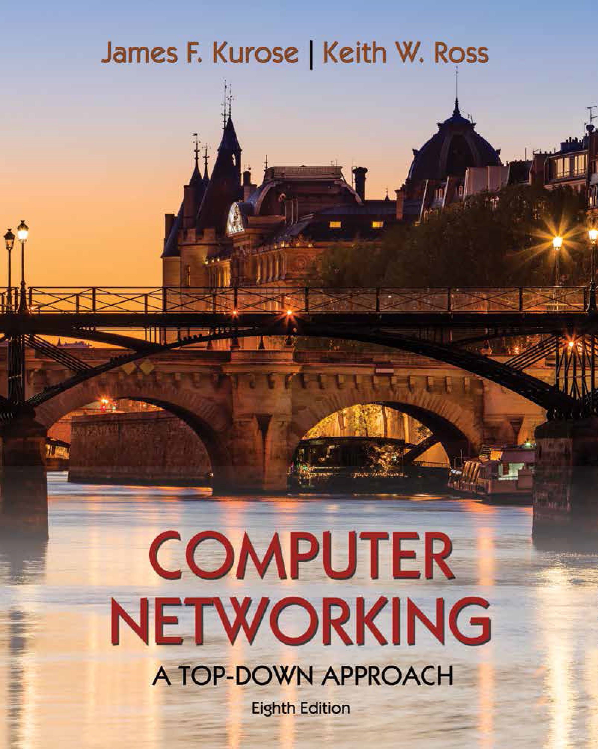
Network Layer: Control Plane
COMPSCI 453 Computer Networks
Professor Jim Kurose
College of Information and Computer Sciences
University of Massachusetts
Introduction: network-layer control plane
Routing algorithms
Intra-ISP routing: OSPF
routing among ISPs: BGP
SDN control plane
Internet Control Message Protocol
Network management
Class textbook:
Computer Networking: A Top-Down Approach (8th ed.)
J.F. Kurose, K.W. Ross
Pearson, 2020
http://gaia.cs.umass.edu/kurose_ross

Slide 2
Network layer control plane: our goals
understand principles behind network control plane:
traditional routing algorithms
SDN controllers
network management, configuration

Slide 3
Network layer control plane: our goals
understand principles behind network control plane:
traditional routing algorithms
SDN controllers
network management, configuration
instantiation, implementation in the Internet:
OSPF, BGP
OpenFlow, ODL and ONOS controllers
Internet Control Message Protocol: ICMP
SNMP, YANG/NETCONF

Slide 4
Network layer: “control plane” roadmap
introduction
routing algorithms
link state
distance vector
intra-ISP routing: OSPF
routing among ISPs: BGP
SDN control plane
Internet Control Message Protocol

Slide 5

Network layer: “control plane” roadmap
introduction
routing algorithms
link state
distance vector
intra-ISP routing: OSPF
routing among ISPs: BGP
SDN control plane
Internet Control Message Protocol
network management, configuration
SNMP
NETCONF/YANG

Slide 6
Network-layer functions
routing: determine route taken by packets from source to destination
control plane
forwarding: move packets from router’s input to appropriate router output
data plane
Two approaches to structuring network control plane:
per-router control (traditional)
logically centralized control (software defined networking)

Slide 7

Per-router control plane
Individual routing algorithm components in each and every router interact in the control plane
Routing
Algorithm
control
plane
data
plane
values in arriving
packet header
0111
1
3
2

Slide 8
Software-Defined Networking (SDN) control plane
Remote controller computes, installs forwarding tables in routers
Remote Controller
control
plane
data
plane
CA
CA
CA
CA
CA
values in arriving
packet header
0111
1
3
2

Slide 9
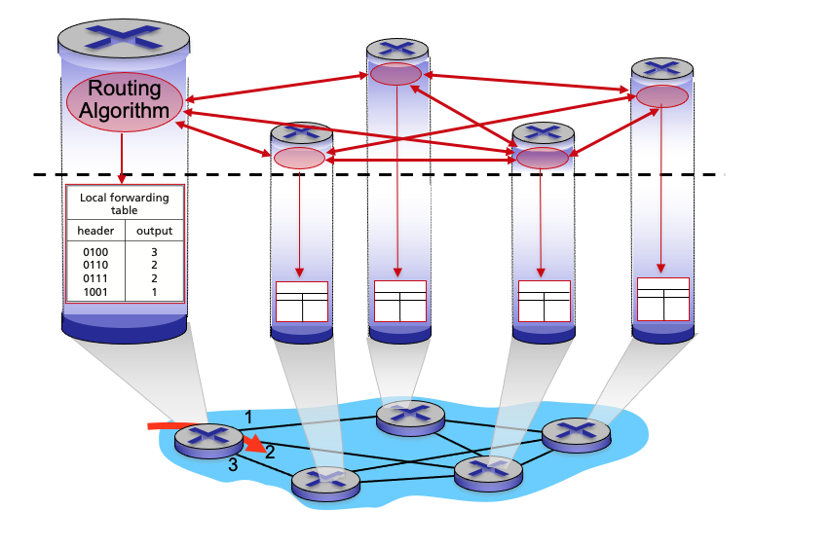
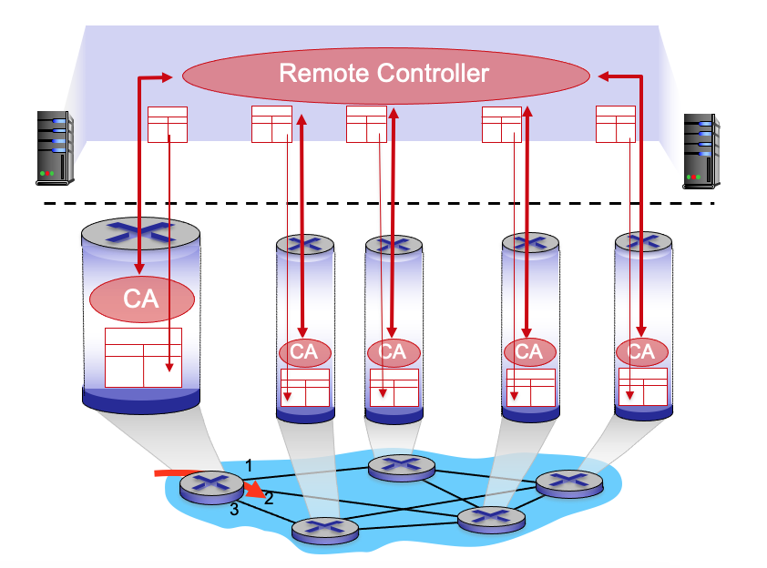
Per-router control plane
SDN control plane

Slide 10

Network Layer: Data Plane
COMPSCI 453 Computer Networks
Professor Jim Kurose
College of Information and Computer Sciences
University of Massachusetts
Introduction: network-layer control plane
Routing algorithms
Intra-ISP routing: OSPF
routing among ISPs: BGP
SDN control plane
Internet Control Message Protocol
Network management
Class textbook:
Computer Networking: A Top-Down Approach (8th ed.)
J.F. Kurose, K.W. Ross
Pearson, 2020
http://gaia.cs.umass.edu/kurose_ross
Video: 2020, J.F. Kurose, All Rights Reserved
Powerpoint: 1996-2020, J.F. Kurose, K.W. Ross, All Rights Reserved

